Slide 1


Assembly Language for x86 Processors 7th Edition
Kip Irvine
Lecture 2: x86 Processor Architecture
(c) Pearson Education, 2015. All rights reserved. You may modify and copy this slide show for your personal use, or for use in the classroom, as long as this copyright statement, the author's name, and the title are not changed.
Last update: 5/04/2019

Slide 2
Lecture Overview
General Concepts
IA-32 Processor Architecture
IA-32 Memory Management
64-bit Processors
Components of an IA-32 Microcomputer
Input-Output System
Irvine, Kip R. Assembly Language for x86 Processors 7/e, 2015.

Slide 3
General Concepts
Basic microcomputer design
Instruction execution cycle
Reading from memory
How programs run
Irvine, Kip R. Assembly Language for x86 Processors 7/e, 2015.

Slide 4
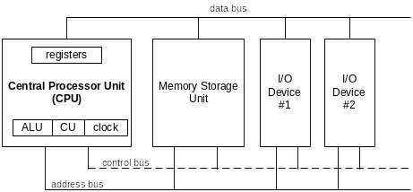
Basic Microcomputer Design
clock synchronizes CPU operations
control unit (CU) coordinates sequence of execution steps
ALU performs arithmetic and bitwise processing
Irvine, Kip R. Assembly Language for x86 Processors 7/e, 2015.

Slide 5
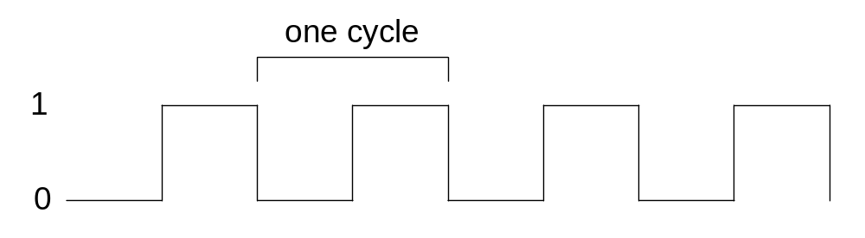
Clock
synchronizes all CPU and BUS operations
machine (clock) cycle measures time of a single operation
clock is used to trigger events
Irvine, Kip R. Assembly Language for x86 Processors 7/e, 2015.

Slide 6
What's Next
General Concepts
IA-32 Processor Architecture
IA-32 Memory Management
64-Bit Processors
Components of an IA-32 Microcomputer
Input-Output System
Irvine, Kip R. Assembly Language for x86 Processors 7/e, 2015.

Slide 7
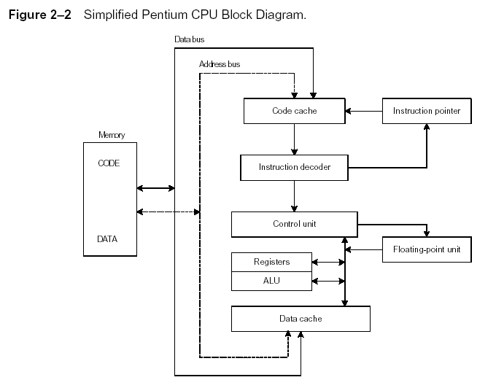
Instruction Execution Cycle
Instruction Execution Cycle
Fetch
Decode
Fetch operands
Execute
Store output
Irvine, Kip R. Assembly Language for x86 Processors 7/e, 2015.

Slide 8
Reading from Memory
Multiple machine cycles are required when reading from memory, because it responds much more slowly than the CPU. The steps are:
  Place the address of the value you want to read on the address bus.
  Assert (changing the value of) the processor’s RD (read) pin.
  Wait one clock cycle for the memory chips to respond.
  Copy the data from the data bus into the destination operand
Irvine, Kip R. Assembly Language for x86 Processors 7/e, 2015.

Slide 9
Cache Memory
High-speed expensive static RAM both inside and outside the CPU.
  Level-1 cache: inside the CPU
  Level-2 cache: outside the CPU
Cache hit: when data to be read is already in cache memory
Cache miss: when data to be read is not in cache memory.
Irvine, Kip R. Assembly Language for x86 Processors 7/e, 2015.

Slide 10
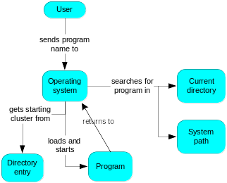
How a Program Runs
Irvine, Kip R. Assembly Language for x86 Processors 7/e, 2015.

Slide 11
IA-32 Processor Architecture
Modes of operation
Basic execution environment
Floating-point unit
Intel Microprocessor history
Irvine, Kip R. Assembly Language for x86 Processors 7/e, 2015.

Slide 12
Modes of Operation
Protected mode
Protected mode is a 32-bit operating mode found on Intel 80286 or newer processors. It provides the access of addressing virtual memory, extended memory, and multitasking, while protecting programs from overwriting one another in memory.
Real-address mode
The mode gets its name from the fact that addresses in real mode always correspond to real locations in memory
System management mode
  power management, system security, diagnostics
Irvine, Kip R. Assembly Language for x86 Processors 7/e, 2015.

Slide 13
Basic Execution Environment
Addressable memory
General-purpose registers
Index and base registers
Specialized register uses
Status flags
Floating-point, MMX, XMM registers
Irvine, Kip R. Assembly Language for x86 Processors 7/e, 2015.

Slide 14
Addressable Memory
Protected mode
  4 GB
  32-bit address
Real-address
  1 MB space
  20-bit address
Irvine, Kip R. Assembly Language for x86 Processors 7/e, 2015.

Slide 15

General-Purpose Registers
Named storage locations inside the CPU, optimized for speed.
Irvine, Kip R. Assembly Language for x86 Processors 7/e, 2015.

Slide 16


Accessing Parts of Registers
Use 8-bit name, 16-bit name, or 32-bit name
Applies to EAX, EBX, ECX, and EDX
Irvine, Kip R. Assembly Language for x86 Processors 7/e, 2015.

Slide 17

Index and Base Registers
Some registers have only a 16-bit name for their lower half:
Irvine, Kip R. Assembly Language for x86 Processors 7/e, 2015.

Slide 18
Some Specialized Register Uses (1 of 2)
General-Purpose
  EAX – accumulator
  ECX – loop counter
  ESP – stack pointer
  ESI, EDI – index registers
  EBP – extended frame pointer (stack)
Segment
  CS – code segment
  DS – data segment
  SS – stack segment
  ES, FS, GS - additional segments
Irvine, Kip R. Assembly Language for x86 Processors 7/e, 2015.

Slide 19
Some Specialized Register Uses (2 of 2)
EIP – instruction pointer
EFLAGS
  status and control flags
  each flag is a single binary bit
Irvine, Kip R. Assembly Language for x86 Processors 7/e, 2015.

Slide 20
Status Flags
Carry
  unsigned arithmetic out of range
Overflow
  signed arithmetic out of range
Sign
  result is negative
Zero
  result is zero
Auxiliary Carry
  carry from bit 3 to bit 4
Parity
  sum of 1 bits is an even number
Irvine, Kip R. Assembly Language for x86 Processors 7/e, 2015.

Slide 21

Floating-Point, MMX, XMM Registers
Eight 80-bit floating-point data registers
  ST(0), ST(1), . . . , ST(7)
  arranged in a stack
  used for all floating-point arithmetic
Eight 64-bit MMX registers
Eight 128-bit XMM registers for single-instruction multiple-data (SIMD) operations
Irvine, Kip R. Assembly Language for x86 Processors 7/e, 2015.

Slide 22
What's Next
General Concepts
IA-32 Processor Architecture
IA-32 Memory Management
64-Bit Processors
Components of an IA-32 Microcomputer
Input-Output System
Irvine, Kip R. Assembly Language for x86 Processors 7/e, 2015.

Slide 23
IA-32 Memory Management
Protected mode
Irvine, Kip R. Assembly Language for x86 Processors 7/e, 2015.

Slide 24
Protected Mode
4 GB addressable RAM
  (00000000 to FFFFFFFFh)
Each program assigned a memory partition which is protected from other programs
Designed for multitasking
Supported by Linux & MS-Windows
Irvine, Kip R. Assembly Language for x86 Processors 7/e, 2015.

Slide 25
What's Next
General Concepts
IA-32 Processor Architecture
IA-32 Memory Management
64-Bit Processors
Components of an IA-32 Microcomputer
Input-Output System
Irvine, Kip R. Assembly Language for x86 Processors 7/e, 2015.

Slide 26
64-Bit Processors
64-Bit Operation Modes
  Compatibility mode – can run existing 16-bit and 32-bit applications (Windows supports only 32-bit apps in this mode)
  64-bit mode – Windows 64 uses this
Basic Execution Environment
  addresses can be 64 bits (48 bits, in practice)
  16 64-bit general purpose registers
  64-bit instruction pointer named RIP
Irvine, Kip R. Assembly Language for x86 Processors 7/e, 2015.

Slide 27
64-Bit General Purpose Registers
32-bit general purpose registers:
  EAX, EBX, ECX, EDX, EDI, ESI, EBP, ESP, R8D, R9D, R10D, R11D, R12D, R13D, R14D, R15D
64-bit general purpose registers:
  RAX, RBX, RCX, RDX, RDI, RSI, RBP, RSP, R8, R9, R10, R11, R12, R13, R14, R15
Irvine, Kip R. Assembly Language for x86 Processors 7/e, 2015.

Slide 28
What's Next
General Concepts
IA-32 Processor Architecture
IA-32 Memory Management
64-Bit Processors
Components of an IA-32 Microcomputer
Input-Output System
Irvine, Kip R. Assembly Language for x86 Processors 7/e, 2015.

Slide 29
Components of an IA-32 Microcomputer
Motherboard
Video output
Memory
Input-output ports
Irvine, Kip R. Assembly Language for x86 Processors 7/e, 2015.

Slide 30
Motherboard
CPU socket
External cache memory slots
Main memory slots
BIOS chips
Sound synthesizer chip (optional)
Video controller chip (optional)
IDE, parallel, serial, USB, video, keyboard, joystick, network, and mouse connectors
PCI bus connectors (expansion cards)
Irvine, Kip R. Assembly Language for x86 Processors 7/e, 2015.

Slide 31
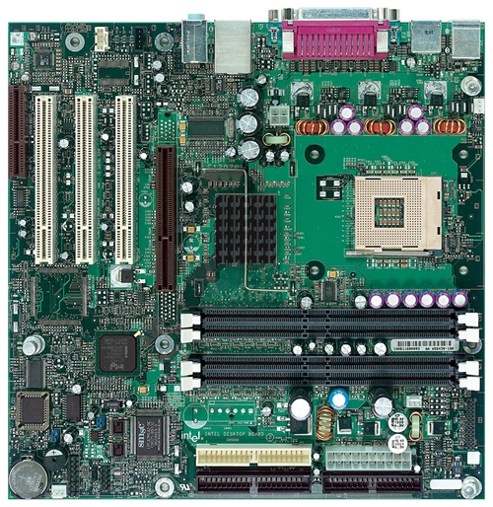
Intel D850MD Motherboard
mouse, keyboard, parallel, serial, and USB connectors
Video
Audio chip
PCI slots
memory controller hub
Pentium 4 socket
AGP slot
dynamic RAM
Firmware hub
I/O Controller
Speaker
Power connector
Battery
Diskette connector
Source: Intel® Desktop Board D850MD/D850MV Technical Product Specification
IDE drive connectors
Irvine, Kip R. Assembly Language for x86 Processors 7/e, 2015.

Slide 32
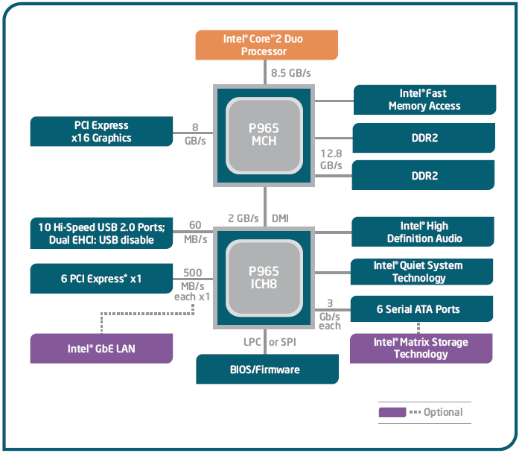
Intel 965 Express Chipset
Irvine, Kip R. Assembly Language for x86 Processors 7/e, 2015.

Slide 33
Video Output
Video controller
  on motherboard, or on expansion card
  AGP (accelerated graphics port technology)*
Video memory (VRAM)
Video CRT Display
  uses raster scanning
  horizontal retrace
  vertical retrace
Direct digital LCD monitors
  no raster scanning required
* This link may change over time.
Irvine, Kip R. Assembly Language for x86 Processors 7/e, 2015.

Slide 34
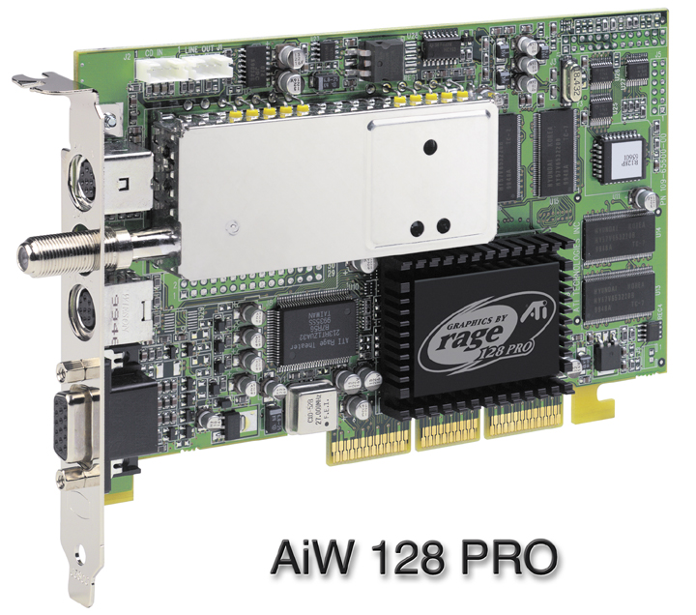
Sample Video Controller (ATI Corp.)
  128-bit 3D graphics performance powered by RAGE™ 128 PRO
  3D graphics performance
  Intelligent TV-Tuner with Digital VCR
  TV-ON-DEMAND™
  Interactive Program Guide
  Still image and MPEG-2 motion video capture
  Video editing
  Hardware DVD video playback
  Video output to TV or VCR
Irvine, Kip R. Assembly Language for x86 Processors 7/e, 2015.

Slide 35
Memory
ROM
  read-only memory
EPROM
  erasable programmable read-only memory
Dynamic RAM (DRAM)
  inexpensive; must be refreshed constantly
Static RAM (SRAM)
  expensive; used for cache memory; no refresh required
Video RAM (VRAM)
  dual ported; optimized for constant video refresh
CMOS RAM
  complimentary metal-oxide semiconductor
  system setup information
See: Intel platform memory (Intel technology brief: link address may change)
Irvine, Kip R. Assembly Language for x86 Processors 7/e, 2015.

Slide 36
Input-Output Ports
USB (universal serial bus)
  intelligent high-speed connection to devices
  up to 12 megabits/second
  USB hub connects multiple devices
  enumeration: computer queries devices
  supports hot connections
Parallel
  short cable, high speed
  common for printers
  bidirectional, parallel data transfer
  Intel 8255 controller chip
Irvine, Kip R. Assembly Language for x86 Processors 7/e, 2015.

Slide 37
Input-Output Ports (cont)
Serial
  RS-232 serial port
  one bit at a time
  uses long cables and modems
  16550 UART (universal asynchronous receiver transmitter)
  programmable in assembly language
Irvine, Kip R. Assembly Language for x86 Processors 7/e, 2015.

Slide 38
Device Interfaces
ATA host adapters
  intelligent drive electronics (hard drive, CDROM)
SATA (Serial ATA)
  inexpensive, fast, bidirectional
FireWire
  high speed (800 MB/sec), many devices at once
Bluetooth
  small amounts of data, short distances, low power usage
Wi-Fi (wireless Ethernet)
  IEEE 802.11 standard, faster than Bluetooth
Irvine, Kip R. Assembly Language for x86 Processors 7/e, 2015.

Slide 39
What's Next
General Concepts
IA-32 Processor Architecture
IA-32 Memory Management
Components of an IA-32 Microcomputer
Input-Output System
Irvine, Kip R. Assembly Language for x86 Processors 7/e, 2015.

Slide 40
Levels of Input-Output
Level 3: High-level language function
  examples: C++, Java
  portable, convenient, not always the fastest
Level 2: Operating system
  Application Programming Interface (API)
  extended capabilities, lots of details to master
Level 1: BIOS
  drivers that communicate directly with devices
  OS security may prevent application-level code from working at this level
Irvine, Kip R. Assembly Language for x86 Processors 7/e, 2015.

Slide 41
Displaying a String of Characters
When a HLL program displays a string of characters, the following steps take place:
Irvine, Kip R. Assembly Language for x86 Processors 7/e, 2015.

Slide 42
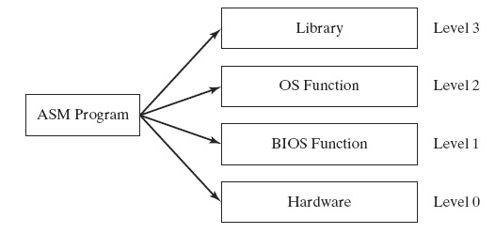
Programming levels
Assembly language programs can perform input-output at each of the following levels:
Irvine, Kip R. Assembly Language for x86 Processors 7/e, 2015.

Slide 43
Summary
Central Processing Unit (CPU)
Arithmetic Logic Unit (ALU)
Instruction execution cycle
Multitasking
Floating Point Unit (FPU)
Complex Instruction Set
Real mode and Protected mode
Motherboard components
Memory types
Input/Output and access levels
Irvine, Kip R. Assembly Language for x86 Processors 7/e, 2015.

Slide 44

42 69 6E 61 72 79
What does this say?
Irvine, Kip R. Assembly Language for x86 Processors 7/e, 2015.

